Slide 3
Taking Back Control with Azure Governance
Sam Cogan

Slide 4




Sam Cogan
Solution Architect – Willis Towers Watson
Microsoft Azure MVP
samcogan.com
@samcogan
sam-cogan

Slide 5
1. Functions
Numeric – add, div, min, max, copyIndex
String – concat, contains, split, replace, trim
Resource – List Keys, ResourceGroup
Deployment – Parameters, Variables
Comparison – equals, greater, less
Logical – and, or, not, if
Array – concat, length, range, take, union
https://docs.microsoft.com/en-us/azure/azure-resource-manager/resource-group-template-functions

Slide 6
2. Custom Functions

Slide 7
3. Outputs
Notes:
Each ARM Template has an Output section
This can contain any information that is available to the template
Resource ID’s
Keys
Parameters and/or variables
Whole resources
Output data is passed to the caller:
PowerShell
Build Tool
Another ARM Template

Slide 8


4. Nested Templates
Notes:
Calling a template from inside another template
Great for re-use and modularisation
Can be used for primitive conditional logic
Can return output to the calling script
Required for some techniques, including cross subscription deployments

Slide 9
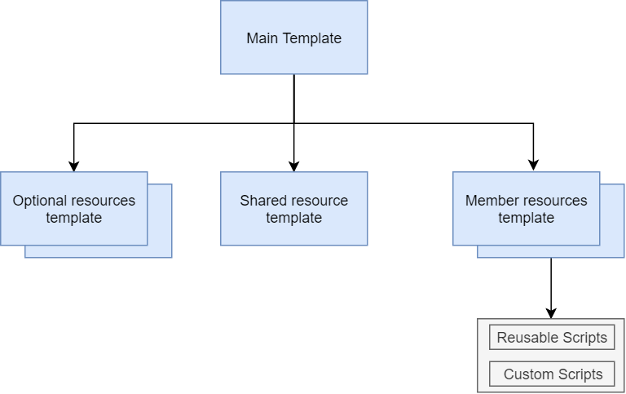
4. Nested Templates

Slide 10


5. T-Shirt Sizing

Slide 11
6. Conditions

Slide 12


7. Subscription Level Deployments

Slide 13
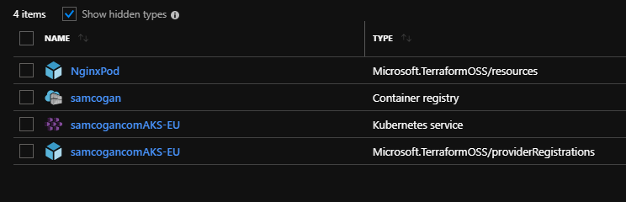
8. External Providers
"type": "Microsoft.TerraformOSS/providerregistrations",

Slide 14
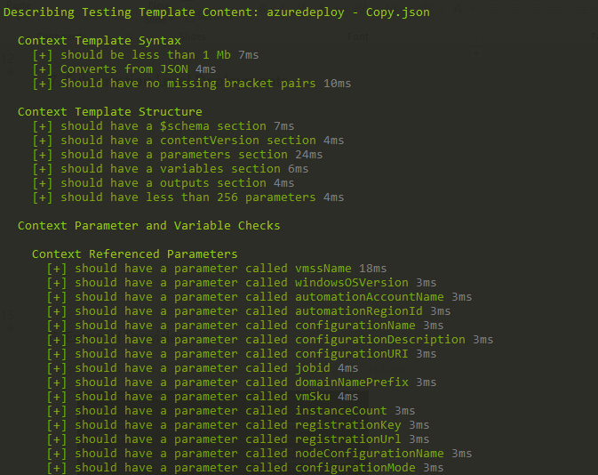
9. Testing

Slide 15


10. Container Jobs

Slide 16
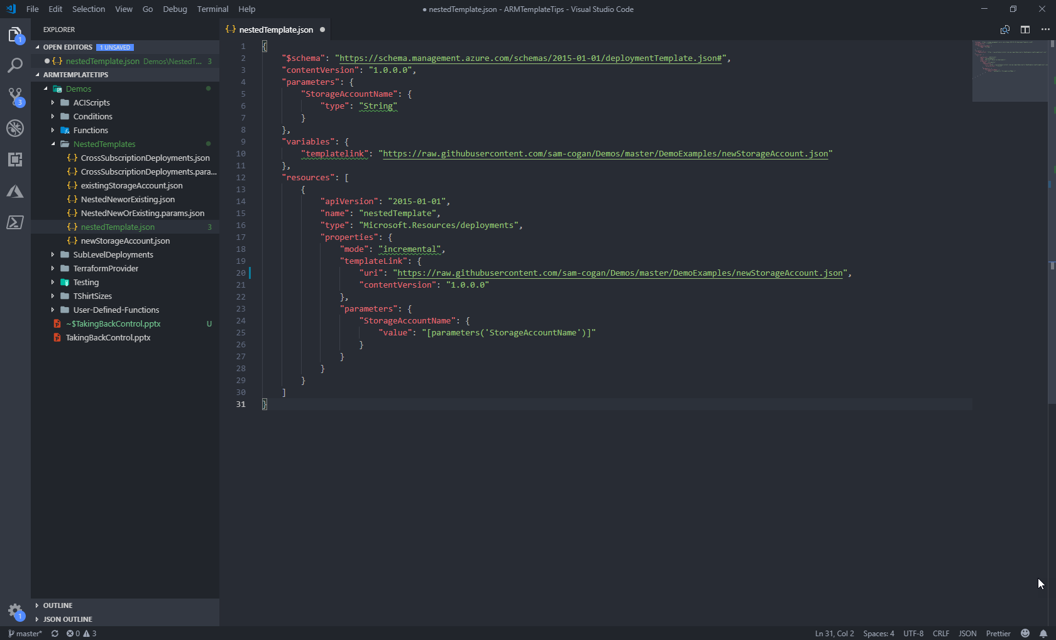
11. Visual Studio Code

